Slide 1

EXAMINATION VERIFICATION SYSTEM USING BIOMETRICS FOR COMPUTER SCIENCE DEPARTMENT KADUNA POLYTECHNIC
AISHAT YAHAYA (CST20HND0740)
Supervised by: DR. HAMISU I.A

Slide 2







Table of Content
Background of the Study
Statement of the Problem
Aim and Objectives
1
2
3
Significance of Study
Summary of Related Literature Reviews
Research Methodology
4
5
6
System Modeling
Proposed Interface Design
Summary / Conclusion
7
8
9

Slide 3
Background of Study
An examination is credible if it is free and fair, free of bias, cheating, and other types of examination malpractice. One of the most common types of test misconduct is candidate impersonation. The idea is to engage a more competent individual as machinery to write the exam for the original candidate. An invigilator recognizes a real applicant by his identity card, which includes his name, photo, and other pertinent information. Only the candidate's photo is verified on the spot out of all the information on the Identity card. That is, the invigilator examines the candidate's face and compares it to the image on the identity card. Unknown to him, the impostor's photo might be on the identity card, while other information belongs to the true owner. Rufai et al. (2017)
According to a recent study by (Patrick et al., 2019) The process of determining the truth, correctness, or validity of anything, such as the verification of official papers, is known as verification. Realistic authentication such as biometrics is a type of physical or behavioral human features that may be used to digitally identify a person to get access to systems, devices, or data. (Korolov, 2019).

Slide 4

Statement of the Problem
Impersonation happens frequently in the computer science department at Kaduna polytechnic students can attest to this, but no one would want to sell out the person, even if the management makes sure there’s no loose end for students to carry out such dubious acts like laminating the examination card, the student can still make ways to manipulate things. For example, identical twins from different departments can come in and write exams for his/her second without the invigilator knowing. Students can change passports on the examination card to any other person’s passport so the person can come into the examination hall to write the exam for them just to attain a good result even though the examination card has been laminated but still students can do anything to get what they want, But with the help of an examination biometric verification system, such acts will be difficult to carry out because each student will need to verify his/her identity before going to the exam hall

Slide 5


Aim and Objectives of the Study
Aim
Objectives
To develop an examination verification system using biometrics for the department of computer science at Kaduna polytechnic
Upon opening the newly admitted student file, the administrator would register the student and include their fingerprint in the system, this is how the data set will be generated.
In storing and retrieval of the collected dataset; MySQL which is an open-source relational database, will be used as the database technology.
Vital testing will be carried out in ensuring the efficacy of the research work

Slide 6
Significance of the Study
With the rising occurrence of examination malpractice in the educational sector, school administrators must implement strict security measures to guarantee that exam impersonators' activities cease. The study may influence preventing corruption in the educational system among students and between students and instructors. Every registered student understands that he or she will have to write the exam on his or her own. The mimicry that has eaten the educational system by promoting student laziness would be abolished, and the level of student educational achievement would be raised

Slide 7
Summary of literature review
Title | Author & Year | Description | Merit | Demerits
Deterring Malpractice in a Networked Computer-Based Examination Using Biometric Control Attendance Register | Ojo et al. (2019) | This study focuses on the development of a biometric control examination attendance register to prevent impersonation during examinations | The system discouraged students from impersonating others during exams. | Poor user interface.
Design And Modeling of a Student Verification System in an Examination in Nigeria using Biometric Fingerprint Technology. | Garko and Ahmad (2017). | The research will assist in quickly identifying students who have registered for a certain course and in quickly identifying individuals who are qualified to enter the test hall | When compared to the manual approach of student verification, the system is more secure, and efficient. | Only unit testing was done.
Bio-Metric Enabled Examination Student Verification System. | Math and Prasanna (2019). | In this research, the researchers offer Location Finder, a mobile Web application that allows users to explore their surroundings by exploiting contexts that are significant to them | The gadget is small and simple to use. | A large SD Card is needed to store the file produced by the Arduino.

Slide 8
Summary of literature review
Title | Author & Year | Description | Merit | Demerits
Ensuring Online Exam Integrity Through Continuous Biometric Authentication. | Traoré et al. (2017). | This article proposes a multimodal biometric architecture for continuous authentication of online test takers | The system allows for live video broadcasting as well as the recording of exam environments. | Changes in lighting circumstances, such as shutting off the light during the exam might have a
sVeriTool: A Verification Tool for Preventing Impersonation of Students in Examination Halls Using Fingerprints. | Haruna (2018). | E-Invigilation is a biometric technology based on fingerprints that may be used for student verification during examinations with the primary goal of eradicating impersonation as a type of test misconduct. | The system provided reliable identification and verification mechanism | The verification can only be done with the system that has the program installed

Slide 9
Research methodology
Choice of programming language
Method of data collection
This research work will be a desktop-based application and will be implemented on a relational database system, VB.net, and the FastCode (SDK) for finger identification to connect with the Digital Persona U 4500 fingerprint scanner. The above are the modern languages used in implementing this system
Before developing any system, collecting data and facts about the existing system is critical to understand what is going on. This research was carried out using three methods.
Observation of the Work Environment
Interview
Documentation

Slide 10
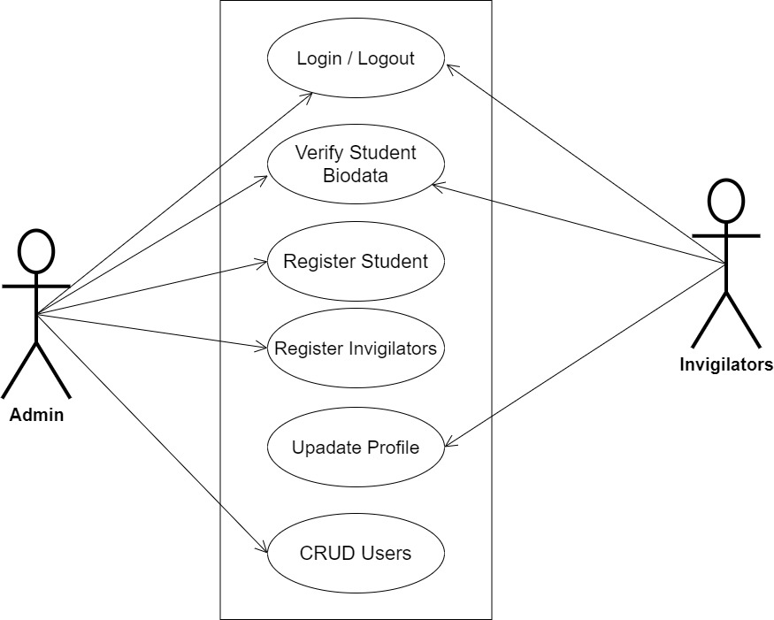
SYSTEM MODELING (USE CASE DIAGRAM)

Slide 11
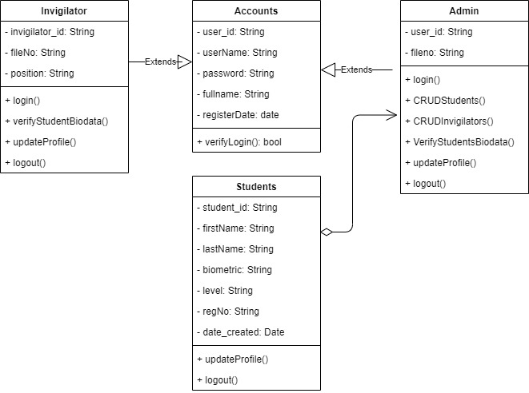
SYSTEM MODELING (CLASS DIAGRAM)

Slide 12
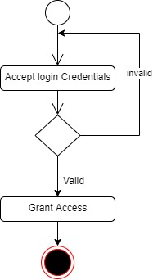
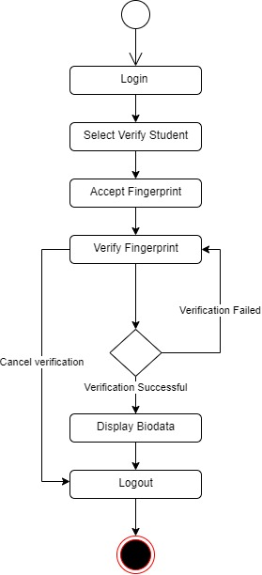
SYSTEM MODELING (ACTIVITY DIAGRAM)
Login Activity Diagram
Biodata Verification Diagram

Slide 13
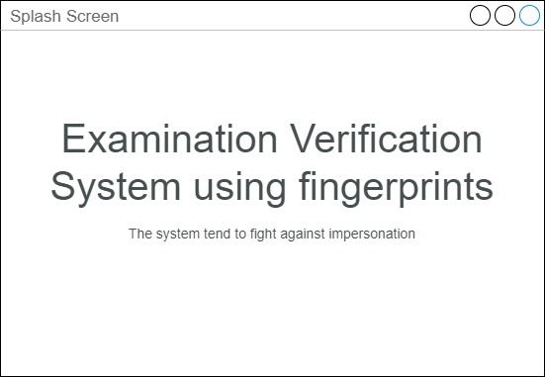
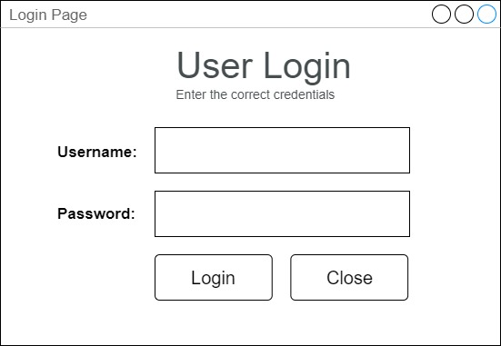
PROPOSED INTERFACE DESIGN
Splash Screen
User Login Screen

Slide 14
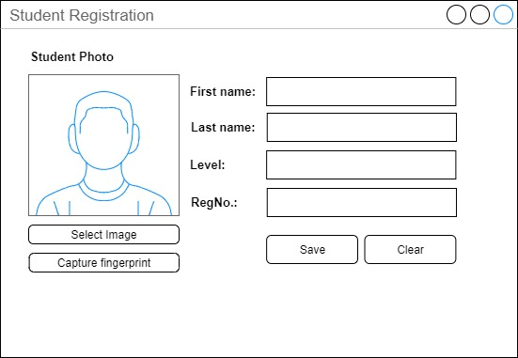
PROPOSED INTERFACE DESIGN
Student Registration Screen

Slide 15
Summary / Conclusion
This research work would include an investigation of the current methods used to verify the identity of students during exams, and an evaluation of the feasibility and potential benefits of implementing a biometric-based verification system. The research work will only be on an examination base and not on any other type of assessment

Slide 16
Thank You

